Slide 1
Manpower Planning

Slide 2
Manpower planning is the process which includes forecasting, developing and controlling by which a firm ensures that it has:-
The right number of people.
The right kind of people
At right place
At right time.
Manpower planning is also known as personnel planning or human resource planning.
Manpower planning involves two stages:
Planning of manpower requirements
Planning of manpower supplies
Objectives:
To utilize the present employees fully.
To fill up future manpower requirements.
To check the development of the employees for organizational growth.
To achieve organizational goals in an efficient way.
To manage and utilize resources properly and effectively.

Slide 3
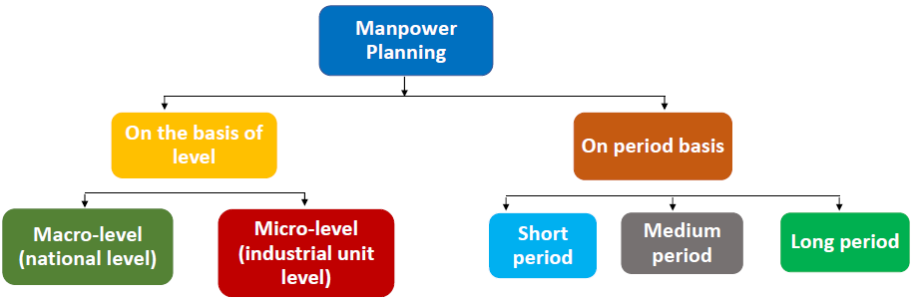
Importance:
The first step towards manpower management.
Using available assets for the implementation of the business plans.
Coordinates and controls various activities in the organization.
Efficient utilization & skilled labour.
Higher productivity.

Slide 4
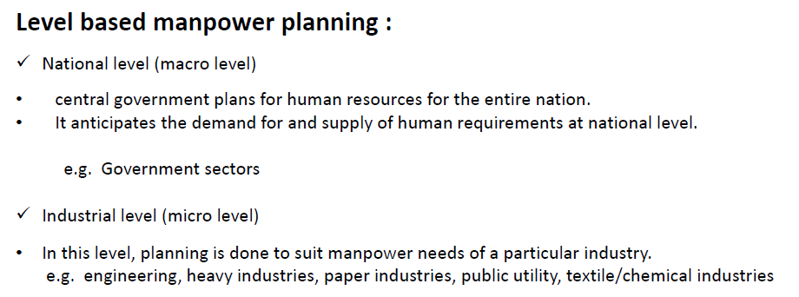

Slide 5
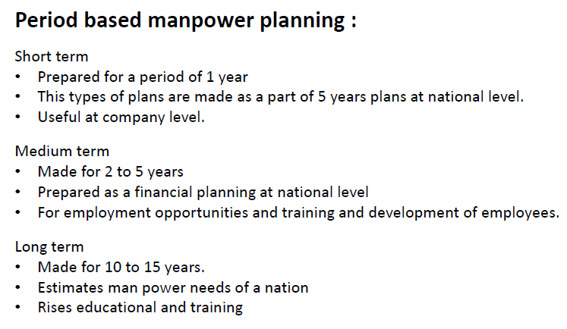

Slide 6
